Slide 1
Predicting Home Run Rate in MLB Pitchers
JITHENDRA SADU

Slide 2
Table of contents
01
04
02
05
03
06
Introduction
Model selection
Dataset overview
Random Forests
Preliminary Analysis
Conclusion

Slide 3

Question of Interest
What factors under a pitcher’s control contribute to their home run rate?

Slide 4
01
Introduction

Slide 5
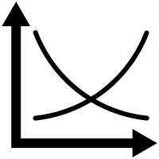

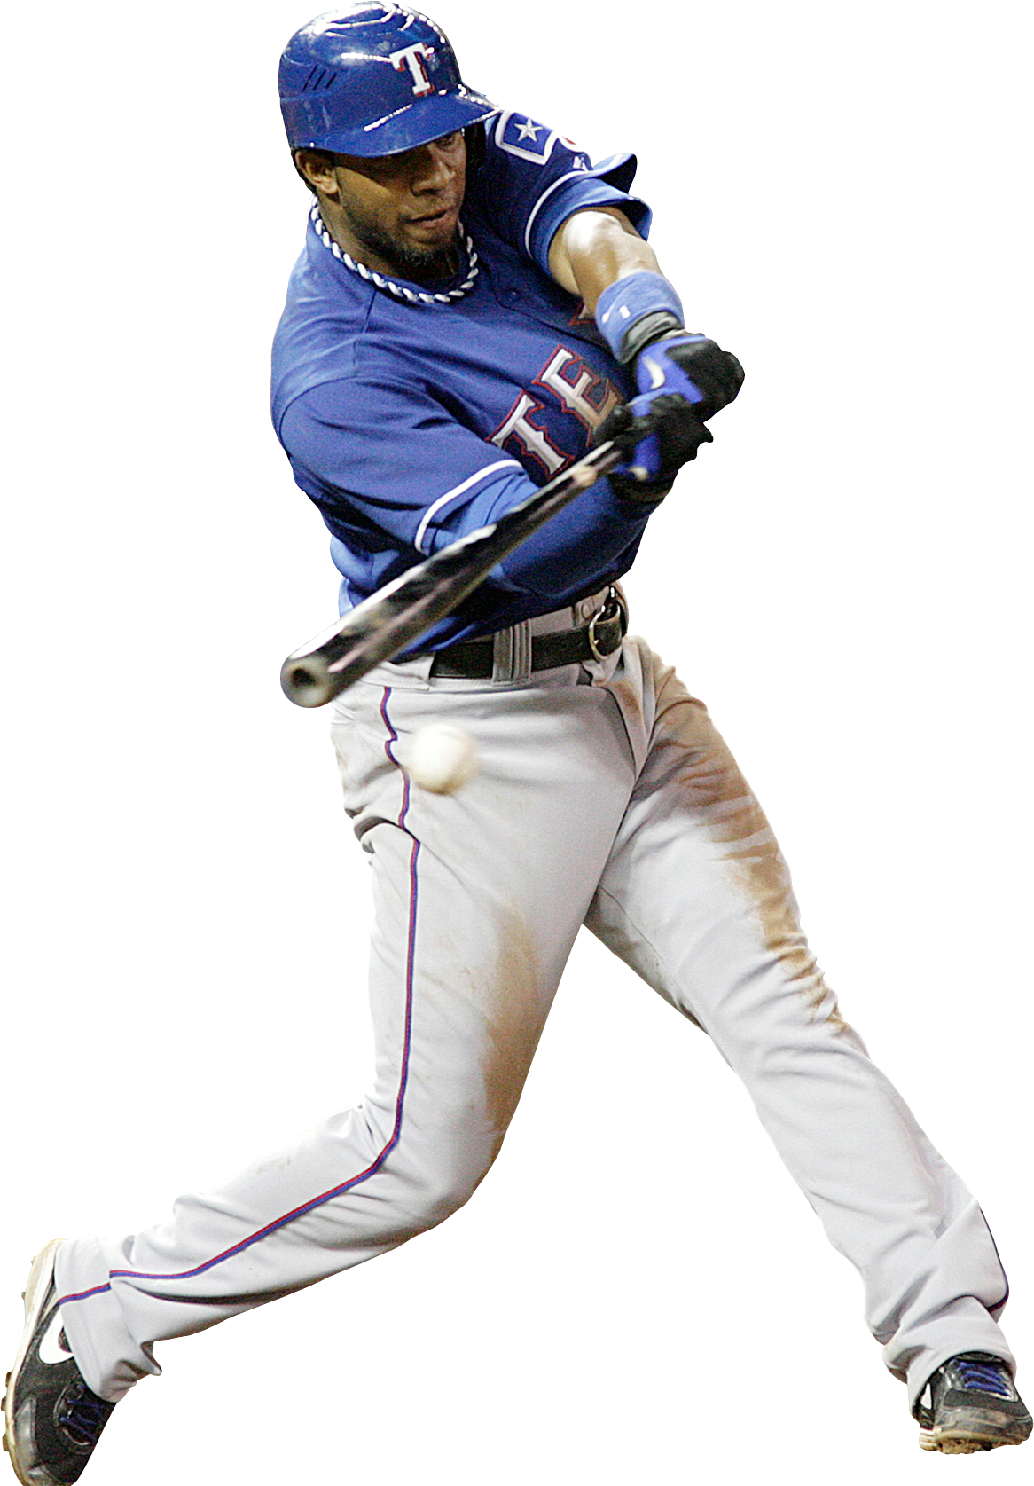

Importance of Regression in Sports
To understand and improve Team’s performance
Clear, concise insights which can be used for player performance
Fine tuning player’s performance
Accurately predict Scores

Slide 6
02
Dataset overview

Slide 7
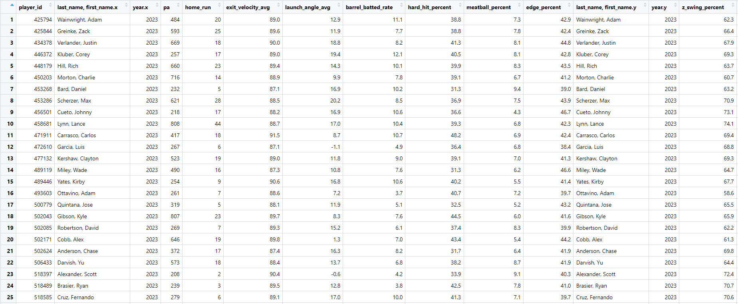
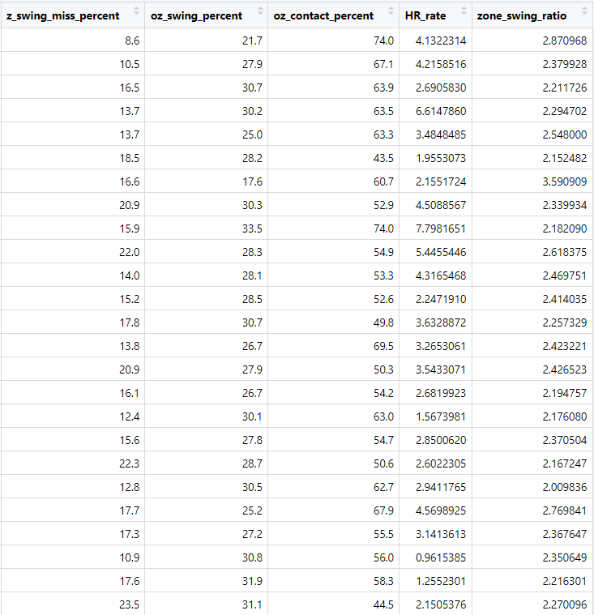
Dataset Snapshot

Slide 8
Dataset Parameters in Focus
The following variables are what batters do once they make contact against pitchers:
Mean exit velocity allowed on contact
Mean launch angle allowed on contact
“Barrel rate” (somewhat of a combination of exit velocity and launch angle)
Percentage of contact 95+ MPH
The following variables are examples of where pitchers throw the ball:
Percentage of pitches thrown down the middle of the plate
Rate of pitches low in the zone, up in the zone, and out of the zone
Percentage of pitches thrown on the edges.shadow of the strike zone

Slide 9
Dataset Overview
Variables:
16 variables in total.
Capturing various metrics related to baseball players.
Dependent Variable:
"HR_rate" represents the home run rate for each player.
Question of Interest:
Question:
What factors under a pitcher’s control contribute to their home run rate?
Significance:
Minimizing home runs is crucial for pitchers in baseball.
Data Acquisition:
Sourced from Major League Baseball’s official advanced statistics database, Baseball Savant (http://baseballsavant.mlb.com).

Slide 10
03
Preliminary Analysis

Slide 11
Preliminary Analysis
Identifying basic trends in the data by:
Generating Histogram and summary statistics of Home Run Rate to highlight trends
Identification of outliers using boxplots.
Generating Scatter plots and correlation to explore relationships between variables.
Performing Regression models to observe the variable influences.

Slide 12
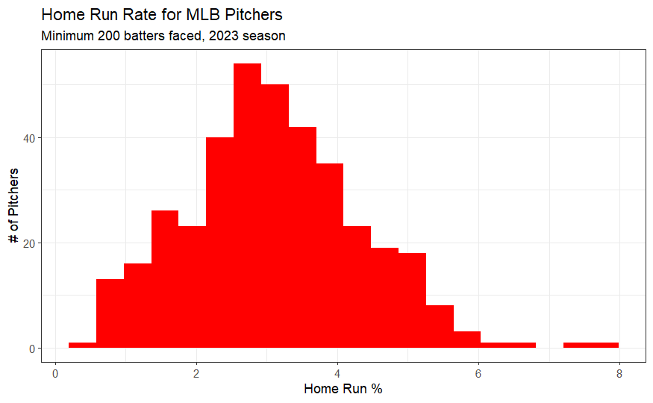
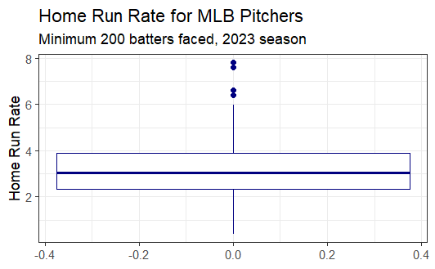

Homerun Rate for MLB Pitchers

Slide 13
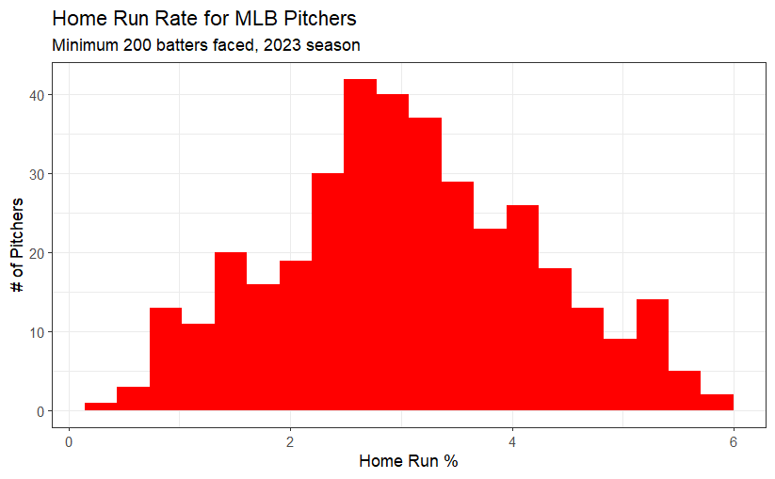
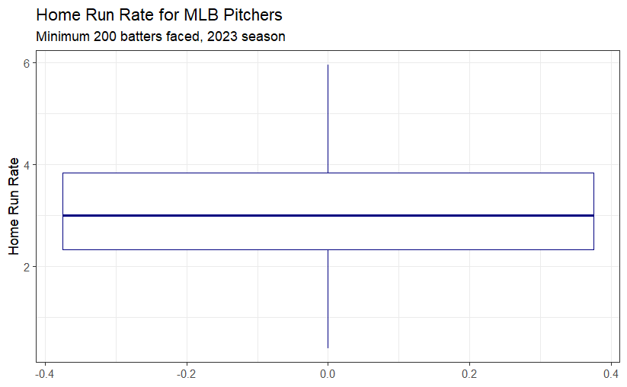

Homerun Rate for MLB Pitchers

Slide 14
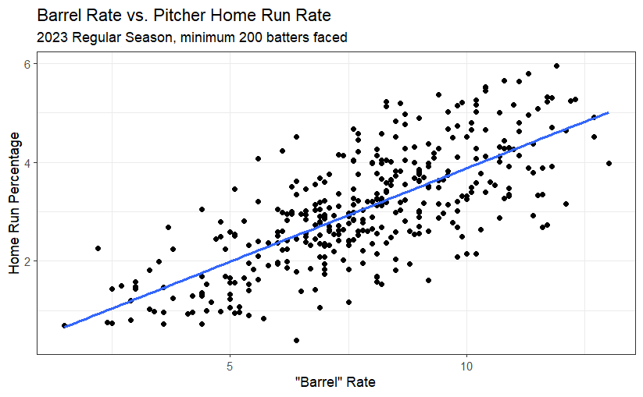
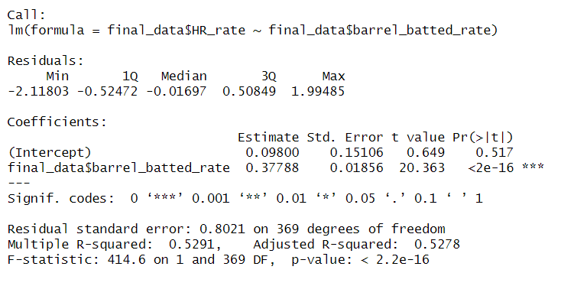
Impact of Barrel Rate on Pitcher Home Run Rate

Slide 15
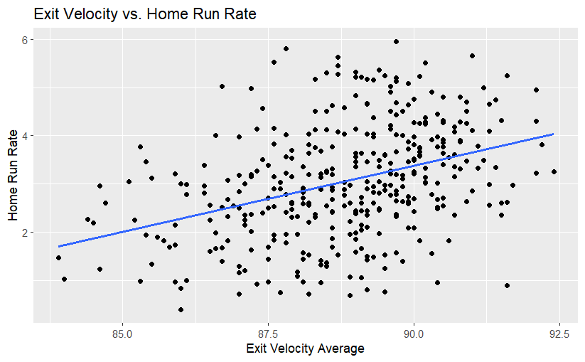
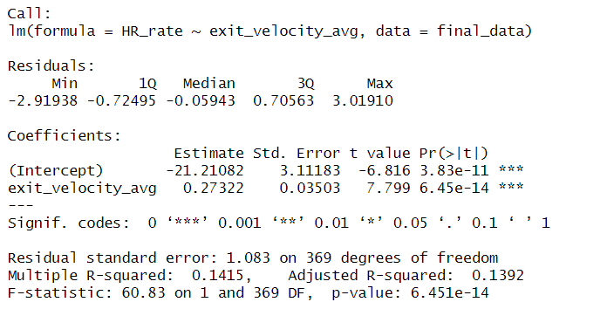
Unveiling the Power: Exit Velocity's Impact on Home Run Rate

Slide 16
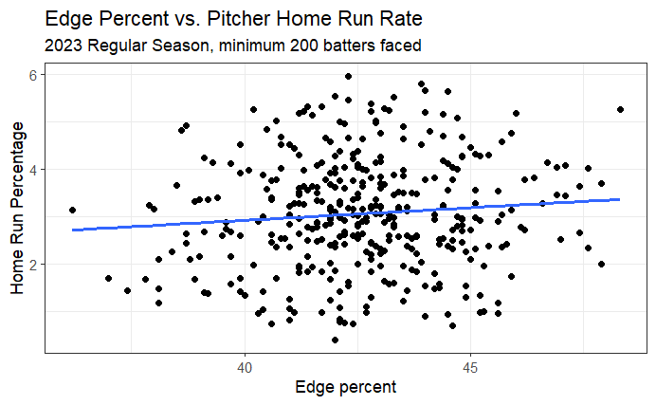
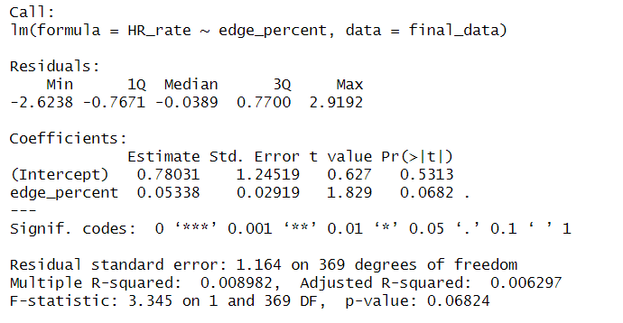
Pitch location metrics

Slide 17
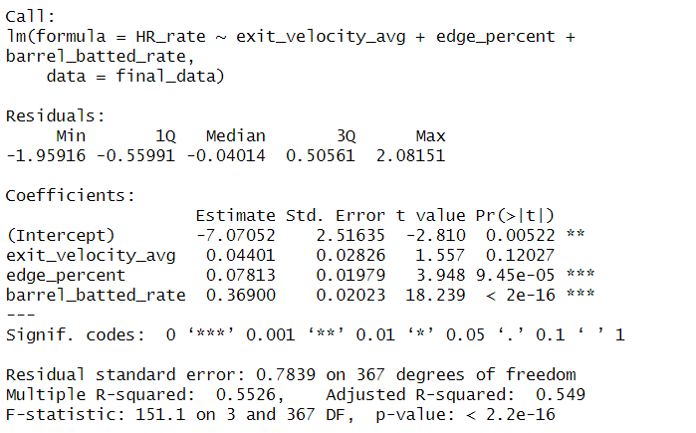
Overall Influence

Slide 18
04
Model Selection

Slide 19
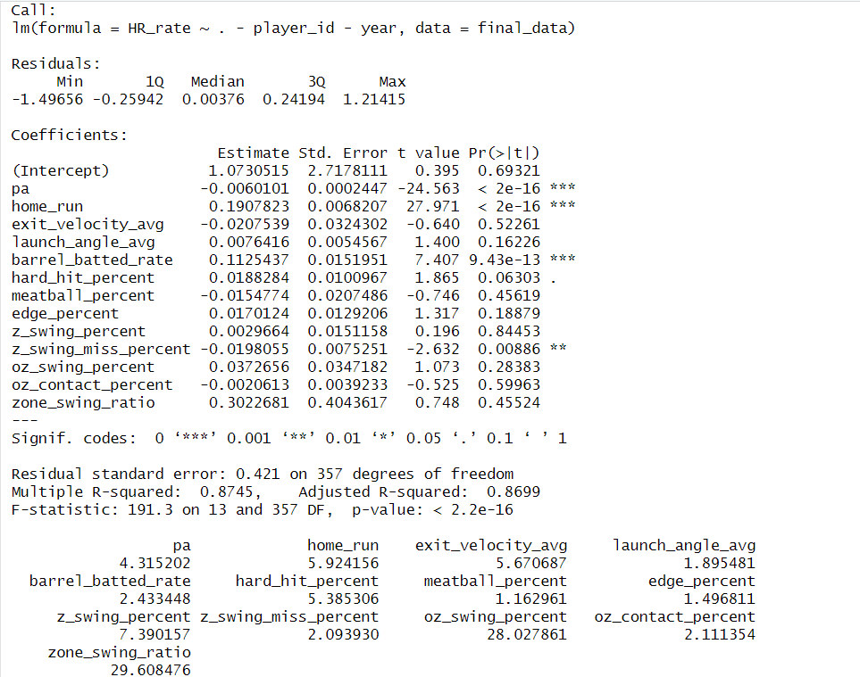
Initial model: With all the variables using the final data.
Only 4 variables are statistically significant
Multiple R-Squared: 87.45%
Residual Standard Error: 0.421 on 357 df
High VIF with ‘oz swing percent’ and ‘zone swing ratio’

Slide 20
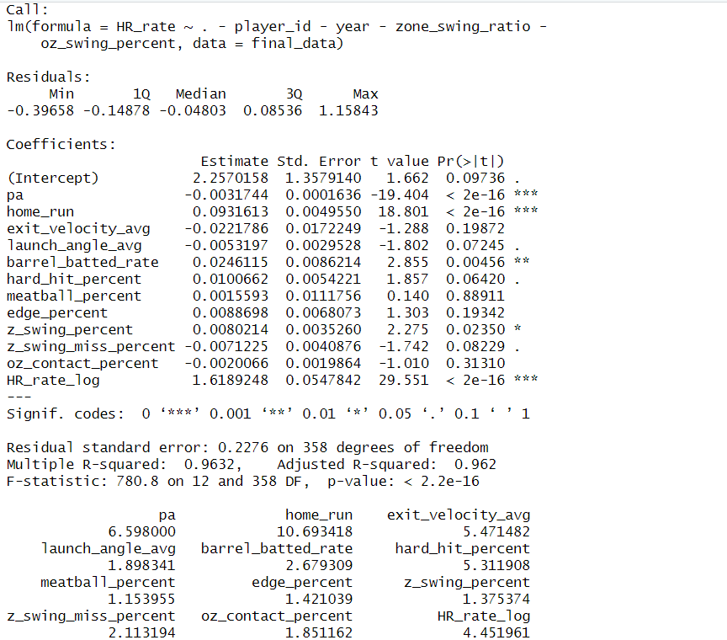
Reduced model: After removing both high VIF variables
5 variables are statistically significant
Intercept and 3 other variables are marginally significant
Multiple R-Squared: 96.32%
Residual Standard Error: 0.228 on 358 df
There are no variables which are high.
R-Squared valve has improved a lot
More number of variables are significant
Residual standard error has also reduced.
No variables with high VIF

Slide 21
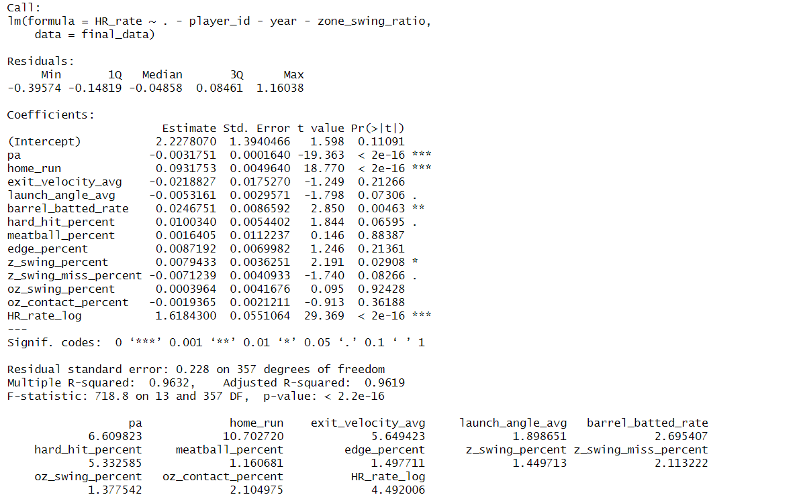
Final model: After removing ‘zone swing ratio’ from model
5 variables are statistically significant
3 other variables are marginally significant
Multiple R-Squared: 96.32%
Residual Standard Error: 0.228 on 357 df
There are no variables which are high.
R-Squared valve is same
Same number of variables are significant
Residual standard error is also not changed
The spread of residuals has also reduced

Slide 22
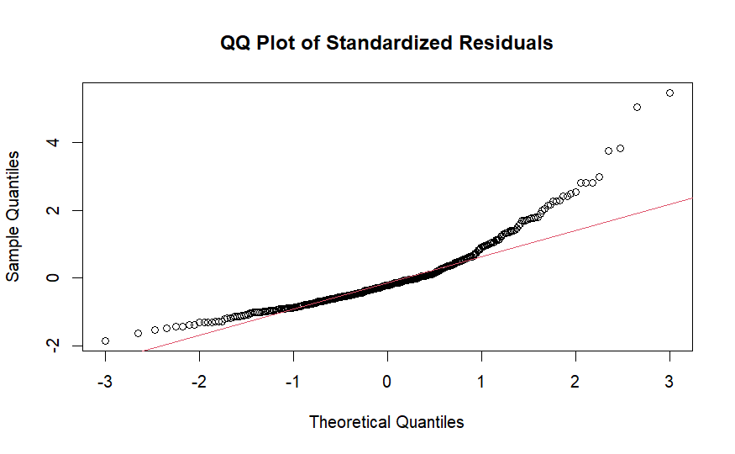
QQ plot of Standardized residuals
Points in the middle of the QQ plot align closely with the expected line indicates that the central portion of the data follows a normal distribution.
Points in the tails deviate from the expected line.
Let us check if we can improve the model by Log Transforming.

Slide 23
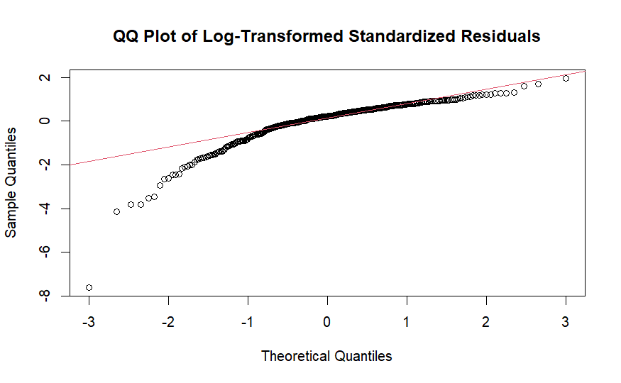
QQ plot of Log Transformed Standardized residuals
Improved in 1 tail but points on the other tail deviate from the expected line.

Slide 24
05
Random Forests:

Slide 25
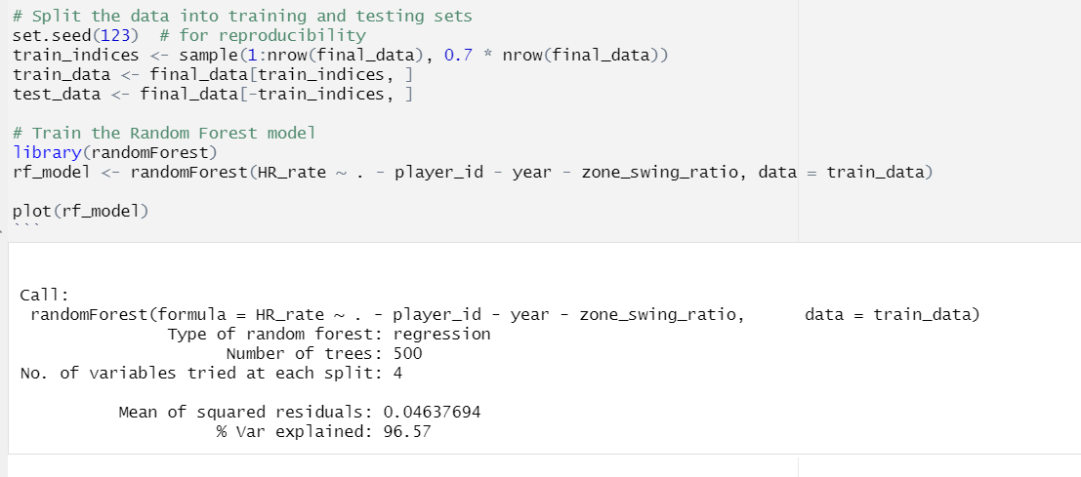
Random Forests:

Slide 26
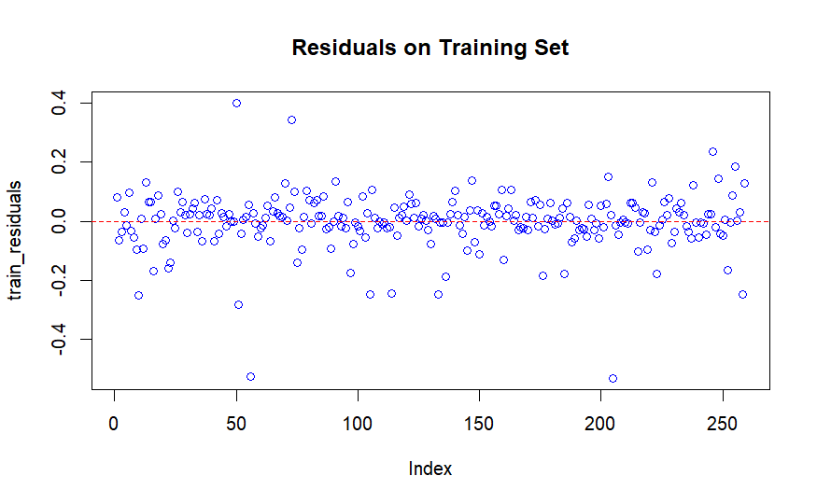
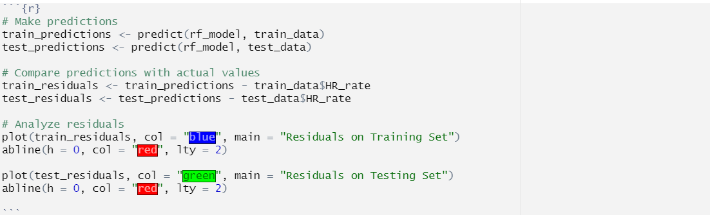
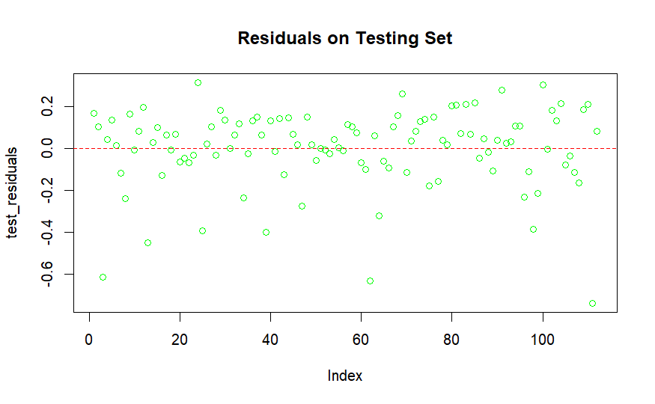
Final model: After removing which has high

Slide 27
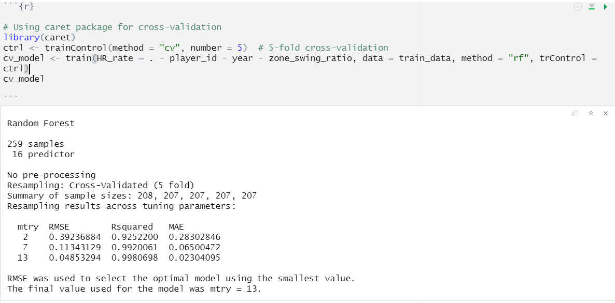
Using CV model and training the data:

Slide 28
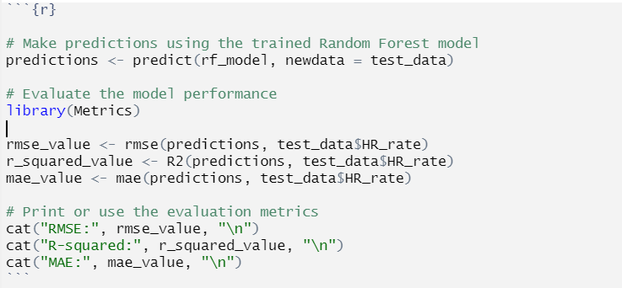

Final model:

Slide 29
06
Conclusion

Slide 30
Insights:
Utilized Random Forest regression model
Excluded non-significant variables (zone_swing_ratio)Dependent Variable.
Model Evaluation:
Test data performance metrics:
RMSE: 0.1854826
R-squared: 0.982332
MAE: 0.133049
The Random Forest model demonstrates exceptional predictive power.
Factors such as plate appearances (pa), home runs, and other metrics significantly influence a pitcher's home run rate.
Highly related with Exit velocity

Slide 31
Implications:
By understanding these factors, coaches and players can strategize to minimize home runs, a critical aspect in baseball.
Player Development Strategies:
Tailor training programs for pitchers based on influential factors.
Foster player development by honing skills that directly impact home run prevention.
Scouting and Recruitment:
Refine scouting processes by prioritizing players with strengths in critical metrics.
Improve recruitment strategies by identifying potential assets for the team.

Slide 32
Thanks..!

